Slide 1
Mixed Ratio Problems
EQ: Where could I use this in a real world situation?

Slide 2
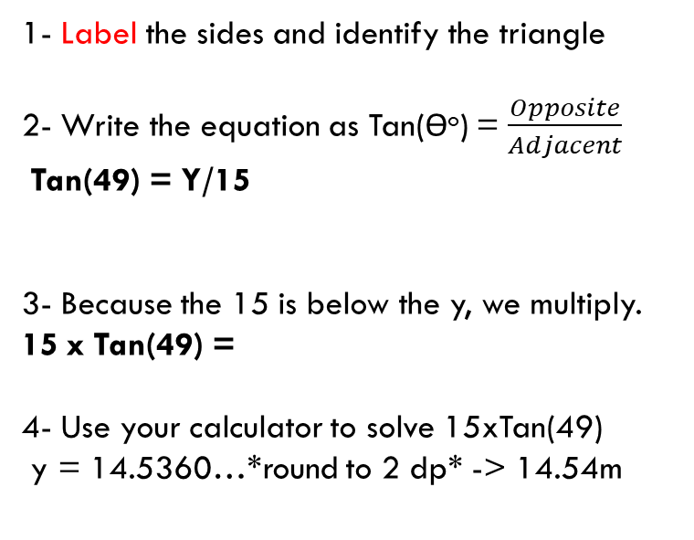
Mixed Ratio Problems
EQ: Where could I use this in a real world situation?
1- Label the sides and identify the triangle
2- Write the equation as Tan(ϴº) = $\frac{Opposite}{Adjacent}$
Tan(49) = Y/15
3- Because the 15 is below the y, we multiply.
15 x Tan(49) =
4- Use your calculator to solve 15xTan(49)
y = 14.5360…*round to 2 dp* -> 14.54m
Opposite
Y
49º
15 m
Adjacent

Slide 3
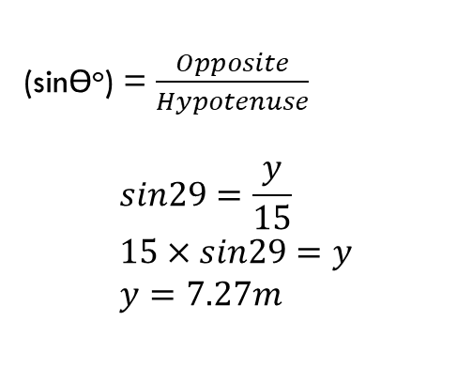
Mixed Ratio Problems
EQ: Where could I use this in a real world situation?
(sinϴº) = $\frac{Opposite}{Hypotenuse}$
$$sin29=\frac{y}{15} \\ 15×sin29=y \\ y=7.27m$$
15 m
Y
1- Label the sides
29º
Practise Question

Slide 4
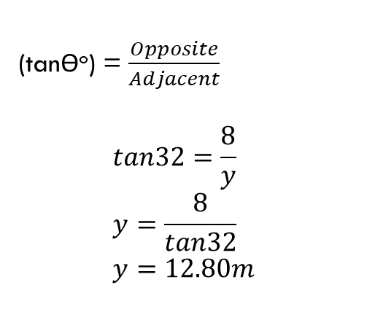
Mixed Ratio Problems
EQ: Where could I use this in a real world situation?
32º
(tanϴº) = $\frac{Opposite}{Adjacent}$
$$tan32=\frac{8}{y} \\ y=\frac{8}{tan32} \\ y=12.80m$$
Y
1- Label the sides
8 m
Practise Question

Slide 5
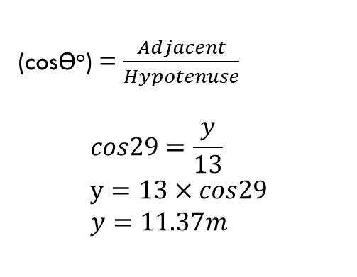
Mixed Ratio Problems
EQ: Where could I use this in a real world situation?
13 m
(cosϴº) = $\frac{Adjacent}{Hypotenuse}$
$$cos29=\frac{y}{13} \\ y=13×cos29 \\ y=11.37m$$
1- Label the sides
29º
Practise Question
Y

Slide 6
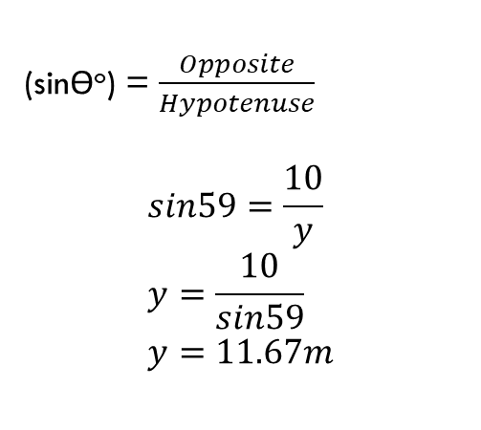
Mixed Ratio Problems
EQ: Where could I use this in a real world situation??
(sinϴº) = $\frac{Opposite}{Hypotenuse}$
$$sin59=\frac{10}{y} \\ y=\frac{10}{sin59} \\ y=11.67m$$
10 m
Y
1- Label the sides
59º
Practise Question

Slide 7
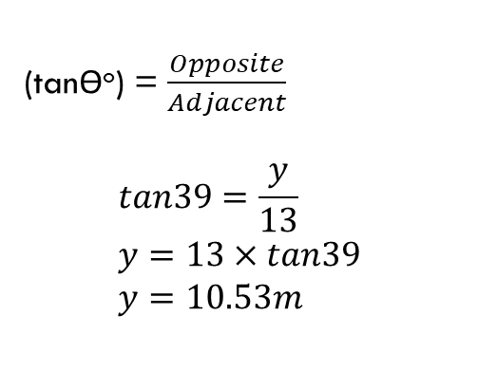
Mixed Ratio Problems
EQ: Where could I use this in a real world situation?
(tanϴº) = $\frac{Opposite}{Adjacent}$
$$tan39=\frac{y}{13} \\ y=13×tan39 \\ y=10.53m$$
Y
1- Label the sides
39º
Practise Question
13 m

Slide 8
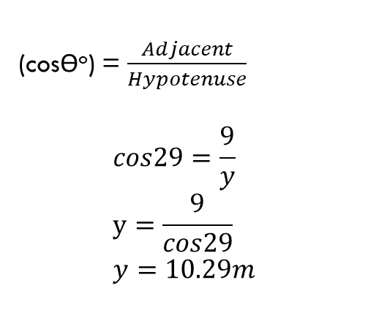
Mixed Ratio Problems
EQ: Where could I use this in a real world situation?
Y
(cosϴº) = $\frac{Adjacent}{Hypotenuse}$
$$cos29=\frac{9}{y} \\ y=\frac{9}{cos29} \\ y=10.29m$$
1- Label the sides
29º
Practise Question
9 m

Slide 9
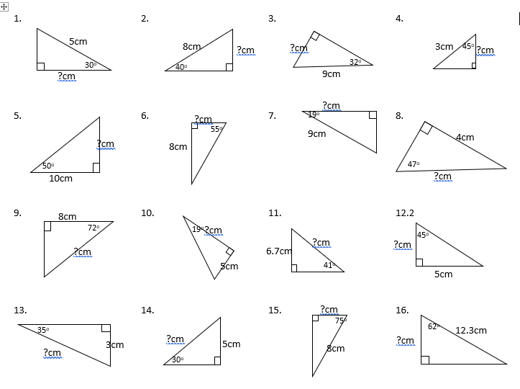
Complete the mixed question worksheet

